Slide 1


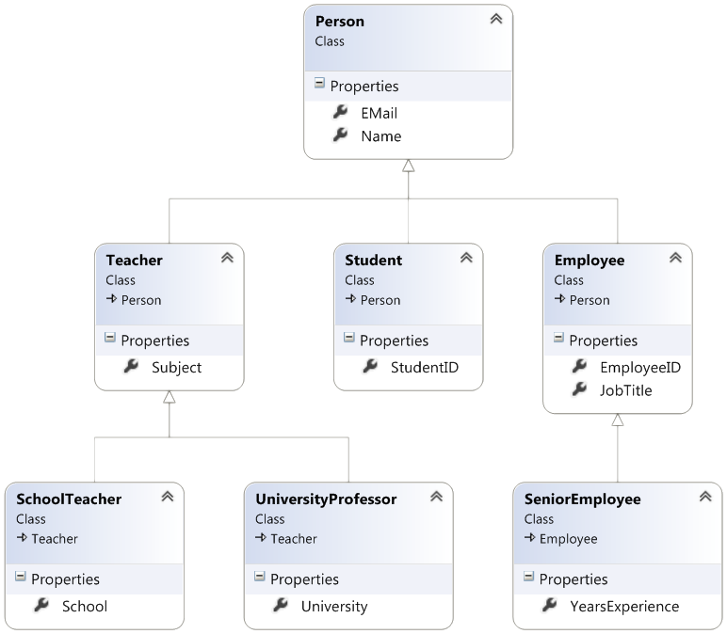

Inheritance and Generics
Class Hierarchies
C# OOP
Intro
SoftUni Team
Technical Trainers
Software University
http://softuni.bg

Slide 2

Table of Contents
Inheritance
Class Hierarchies
Inheritance in C#
Accessing Members of the Base Class
Overriding Methods
Generic Classes – Structure and Usage

Slide 3
Questions
sli.do #CSharpDB

Slide 4
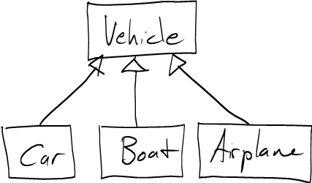
Inheritance
Extending Classes

Slide 5
Inheritance
Superclass - Parent class, Base Class
The class giving its members to its child class
Subclass - Child class, Derived Class
The class taking members from its base class
Base
Superclass
Derived
Subclass

Slide 6
Inheritance – Example
Base class
Person
+Name: string
+Address: string
Derived class
Derived class
Employee
Student
+Company: string
+School: string

Slide 7
Class Hierarchies
Inheritance leads to hierarchies of classes and/or interfaces in an application:
Base classes hold common characteristics
Game
SinglePlayerGame
MultiplePlayersGame
Minesweeper
Solitaire
BoardGame
…
…
Chess
Backgammon

Slide 8
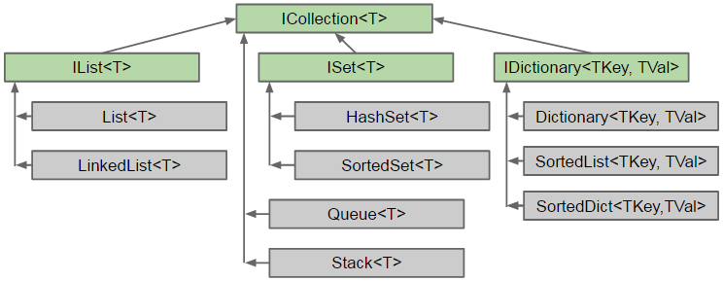
Class Hierarchies – C# Collection

Slide 9
Inheritance in C#
In C# inheritance is defined by the : operator
class Person { … }
class Student : Person { … }
class Employee : Person { … }
Person
Student : Person
Student
Employee
Notes:
Extensibility / Polymorphism: New functionality may be easily plugged in without changing existing classes as long the new plug-in classes extend given base classes.
Reusability: For a set of similar applications a framework can be defined using a core set of classes that are to be extended by classes that fill in the application-dependent part.
Information Hiding: If a more general class using a simpler contract is sufficient, details from extending classes may be hidden to some of the client classes. This allows them to be more independent from possible changes and diminishes the load of contracts that must be understood by a reader of these client classes.
(c) 2006 National Academy for Software Development - http://academy.devbg.org*
9##

Slide 10
Inheritance - Derived Class
A derived class takes all members from its base class
Person
Reusing Person
Mother : Person
Father : Person
Student
Employee
School
Organization

Slide 11
Using Inherited Members
You can access inherited members as usual
class Person { public void Sleep() { … } }
class Student : Person { … }
class Employee : Person { … }
Student student = new Student();
student.Sleep();
Employee employee = new Employee();
employee.Sleep();
Notes:
Extensibility / Polymorphism: New functionality may be easily plugged in without changing existing classes as long the new plug-in classes extend given base classes.
Reusability: For a set of similar applications a framework can be defined using a core set of classes that are to be extended by classes that fill in the application-dependent part.
Information Hiding: If a more general class using a simpler contract is sufficient, details from extending classes may be hidden to some of the client classes. This allows them to be more independent from possible changes and diminishes the load of contracts that must be understood by a reader of these client classes.
(c) 2006 National Academy for Software Development - http://academy.devbg.org*
11##

Slide 12

Problem: Single Inheritance
Animal
+Eat():void
Dog
+Bark():void
Notes:
Extensibility / Polymorphism: New functionality may be easily plugged in without changing existing classes as long the new plug-in classes extend given base classes.
Reusability: For a set of similar applications a framework can be defined using a core set of classes that are to be extended by classes that fill in the application-dependent part.
Information Hiding: If a more general class using a simpler contract is sufficient, details from extending classes may be hidden to some of the client classes. This allows them to be more independent from possible changes and diminishes the load of contracts that must be understood by a reader of these client classes.
(c) 2006 National Academy for Software Development - http://academy.devbg.org*
12##

Slide 13
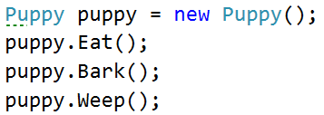
Problem: Multilevel Inheritance
Animal
+Eat():void
Dog
+Bark():void
Puppy
+Weep():void
Notes:
Extensibility / Polymorphism: New functionality may be easily plugged in without changing existing classes as long the new plug-in classes extend given base classes.
Reusability: For a set of similar applications a framework can be defined using a core set of classes that are to be extended by classes that fill in the application-dependent part.
Information Hiding: If a more general class using a simpler contract is sufficient, details from extending classes may be hidden to some of the client classes. This allows them to be more independent from possible changes and diminishes the load of contracts that must be understood by a reader of these client classes.
(c) 2006 National Academy for Software Development - http://academy.devbg.org*
13##

Slide 14
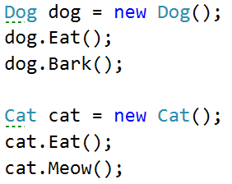
Problem: Hierarchical Inheritance
Animal
+Eat():void
Dog
Cat
-Bark():void
-Meow():void
Notes:
Extensibility / Polymorphism: New functionality may be easily plugged in without changing existing classes as long the new plug-in classes extend given base classes.
Reusability: For a set of similar applications a framework can be defined using a core set of classes that are to be extended by classes that fill in the application-dependent part.
Information Hiding: If a more general class using a simpler contract is sufficient, details from extending classes may be hidden to some of the client classes. This allows them to be more independent from possible changes and diminishes the load of contracts that must be understood by a reader of these client classes.
(c) 2006 National Academy for Software Development - http://academy.devbg.org*
14##

Slide 15
Reusing Constructors
Constructors are not inherited
Constructors can be reused by the child classes
class Student : Person {
private School school;
public Student(String name, School school)
:base(name)
{
this.school = school;
}
}
Notes:
Extensibility / Polymorphism: New functionality may be easily plugged in without changing existing classes as long the new plug-in classes extend given base classes.
Reusability: For a set of similar applications a framework can be defined using a core set of classes that are to be extended by classes that fill in the application-dependent part.
Information Hiding: If a more general class using a simpler contract is sufficient, details from extending classes may be hidden to some of the client classes. This allows them to be more independent from possible changes and diminishes the load of contracts that must be understood by a reader of these client classes.
(c) 2006 National Academy for Software Development - http://academy.devbg.org*
15##

Slide 16
Shadowing Variables
Derived classes can hide base class variables
class Person { protected int weight; }
class Patient : Person
{
protected float weight;
public void Method()
{
double weight = 0.5d;
}
}
hides int weight
hides both
Notes:
Extensibility / Polymorphism: New functionality may be easily plugged in without changing existing classes as long the new plug-in classes extend given base classes.
Reusability: For a set of similar applications a framework can be defined using a core set of classes that are to be extended by classes that fill in the application-dependent part.
Information Hiding: If a more general class using a simpler contract is sufficient, details from extending classes may be hidden to some of the client classes. This allows them to be more independent from possible changes and diminishes the load of contracts that must be understood by a reader of these client classes.
(c) 2006 National Academy for Software Development - http://academy.devbg.org*
16##

Slide 17
Shadowing Variables - Access
Use base and this to specify member access
class Patient : Person
{
protected float weight;
public void Method()
{
double weight = 0.5d;
this.weight = 0.6f;
base.weight = 1;
}
}
Local variable
Instance member
Base class member
Notes:
Extensibility / Polymorphism: New functionality may be easily plugged in without changing existing classes as long the new plug-in classes extend given base classes.
Reusability: For a set of similar applications a framework can be defined using a core set of classes that are to be extended by classes that fill in the application-dependent part.
Information Hiding: If a more general class using a simpler contract is sufficient, details from extending classes may be hidden to some of the client classes. This allows them to be more independent from possible changes and diminishes the load of contracts that must be understood by a reader of these client classes.
(c) 2006 National Academy for Software Development - http://academy.devbg.org*
17##

Slide 18
Thinking About Inheritance - Extends
Derived class instance is an instance of its base class
Student (Derived Class)
+Study():void
Employee (Derived Class)
+Work():void
Person (Base Class)
+Sleep():void

Slide 19
Inheritance
Inheritance has a transitive relation
class Person { … }
class Student : Person { … }
class CollegeStudent : Student { … }
Person
Student
CollegeStudent
Notes:
Extensibility / Polymorphism: New functionality may be easily plugged in without changing existing classes as long the new plug-in classes extend given base classes.
Reusability: For a set of similar applications a framework can be defined using a core set of classes that are to be extended by classes that fill in the application-dependent part.
Information Hiding: If a more general class using a simpler contract is sufficient, details from extending classes may be hidden to some of the client classes. This allows them to be more independent from possible changes and diminishes the load of contracts that must be understood by a reader of these client classes.
(c) 2006 National Academy for Software Development - http://academy.devbg.org*
19##

Slide 20
Multiple Inheritance
In C# there is no multiple inheritance
Only multiple interfaces can be implemented
Person
Student
CollegeStudent
Notes:
Extensibility / Polymorphism: New functionality may be easily plugged in without changing existing classes as long the new plug-in classes extend given base classes.
Reusability: For a set of similar applications a framework can be defined using a core set of classes that are to be extended by classes that fill in the application-dependent part.
Information Hiding: If a more general class using a simpler contract is sufficient, details from extending classes may be hidden to some of the client classes. This allows them to be more independent from possible changes and diminishes the load of contracts that must be understood by a reader of these client classes.
(c) 2006 National Academy for Software Development - http://academy.devbg.org*
20##

Slide 21

Inheritance Benefits – Extension
We can extend a class that we can't otherwise change
Collections
List
Extends
CustomList
Notes:
Extensibility / Polymorphism: New functionality may be easily plugged in without changing existing classes as long the new plug-in classes extend given base classes.
Reusability: For a set of similar applications a framework can be defined using a core set of classes that are to be extended by classes that fill in the application-dependent part.
Information Hiding: If a more general class using a simpler contract is sufficient, details from extending classes may be hidden to some of the client classes. This allows them to be more independent from possible changes and diminishes the load of contracts that must be understood by a reader of these client classes.
(c) 2006 National Academy for Software Development - http://academy.devbg.org*
21##

Slide 22
Problem: Random List
Create a RandomList that has
All functionality of a List<string>
Function that returns and removes a random element
Collections
List<string>
+RandomElement():string
RandomList
Notes:
Extensibility / Polymorphism: New functionality may be easily plugged in without changing existing classes as long the new plug-in classes extend given base classes.
Reusability: For a set of similar applications a framework can be defined using a core set of classes that are to be extended by classes that fill in the application-dependent part.
Information Hiding: If a more general class using a simpler contract is sufficient, details from extending classes may be hidden to some of the client classes. This allows them to be more independent from possible changes and diminishes the load of contracts that must be understood by a reader of these client classes.
(c) 2006 National Academy for Software Development - http://academy.devbg.org*
22##

Slide 23
Solution: Random List
public class RandomList : List<string>
{
private Random rnd; //TODO: Add constructor
public string RandomString()
{
int index = rnd.Next(0, this.Count);
string str = this[index];
this.Remove(str);
return str;
}
}
Notes:
Extensibility / Polymorphism: New functionality may be easily plugged in without changing existing classes as long the new plug-in classes extend given base classes.
Reusability: For a set of similar applications a framework can be defined using a core set of classes that are to be extended by classes that fill in the application-dependent part.
Information Hiding: If a more general class using a simpler contract is sufficient, details from extending classes may be hidden to some of the client classes. This allows them to be more independent from possible changes and diminishes the load of contracts that must be understood by a reader of these client classes.
(c) 2006 National Academy for Software Development - http://academy.devbg.org*
23##

Slide 24
Virtual Methods
virtual – defines a method that can be overriden
public class Animal
{
public virtual void Eat() { … }
}
public class Dog : Animal
{
public override void Eat() {}
}
Notes:
Extensibility / Polymorphism: New functionality may be easily plugged in without changing existing classes as long the new plug-in classes extend given base classes.
Reusability: For a set of similar applications a framework can be defined using a core set of classes that are to be extended by classes that fill in the application-dependent part.
Information Hiding: If a more general class using a simpler contract is sufficient, details from extending classes may be hidden to some of the client classes. This allows them to be more independent from possible changes and diminishes the load of contracts that must be understood by a reader of these client classes.
(c) 2006 National Academy for Software Development - http://academy.devbg.org*
24##

Slide 25

Generic Collections
System.Collections.Generic

Slide 26
Generic Collections
Defined with <Type Parameter 1, Type Parameter 2 … etc.>
Multiple Type Parameters
class List<T>
{
…
}
class Dictionary<TKey, TValue>
{
…
}

Slide 27
Type Parameter Scope
You can use it anywhere inside the declaring class
class List<T>
{
public Add (T element) {…}
public T Remove () {…}
public T { get; }
}

Slide 28
Problem: Storage Box
Create a class Box<> that can store anything
Adding should add on top of its contents
Remove should take last added element
It should have two public methods:
void Add(element)
string Remove()

Slide 29
Solution: Storage Box
public class Box<T>
{
private T[] data;
private int count;
public int Count {//TODO: Add getter and setter}
public Box() {//TODO: Add constructor logic}
//TODO: Add logic to the methods:
public void Add(T element) { }
public T Remove() { }
}

Slide 30
Summary
Inheritance is a powerful tool for code reuse
Subclass inherits members from Superclass
Subclass can override virtual methods
Look for IS-A and IS-A-SUBSTITUTE relationship
Generic collections can be used as containers for different data types

Slide 31







https://softuni.bg/courses/

Slide 32





Trainings @ Software University (SoftUni)
Software University – High-Quality Education, Profession and Job for Software Developers
softuni.bg
Software University Foundation
http://softuni.foundation/
Software University @ Facebook
facebook.com/SoftwareUniversity
Software University Forums
forum.softuni.bg

